Slide 1

OMGT1039
Operations Management
Week 4
Management of Quality

Slide 2
COMMONWEALTH OF AUSTRALIA
Copyright Regulations 1969
WARNING
This material has been reproduced and communicated
to you by or on behalf of Royal Melbourne Institute
of Technology, (RMIT University) pursuant to Part
VB of the Copyright Act 1968 (the Act).
The material in this communication may be subject to
copyright under the Act. Any further reproduction or
communication of this material by you may be the
subject of copyright protection under the Act.
Do not remove this notice.
First page of scanned document
This presentation includes selected slides from
William J Stevenson (2015) Operations Management, 12 ed. ISBN 10: 1259580091, McGraw Hill

Slide 3
Learning Objectives
Define the term quality as it relates to products and as it relates to services
Identify the determinants of quality
Explain why quality is important and the consequences of poor quality
Distinguish the costs associated with quality
List and briefly explain the elements of the control process
Explain how control charts are used to monitor a process

Slide 4
Quality Management
Quality
  The ability of a product or service to consistently meet or exceed customer expectations
    For a decade or so, quality was an important focal point in business. After a while, this emphasis began to fade as other concerns took precedence
    There has been a recent resurgence in attention to quality given recent experiences with the costs and adverse attention associated with highly visible quality failures:
      Auto recalls
      Toys
      Produce
      Pharmaceuticals

Slide 5
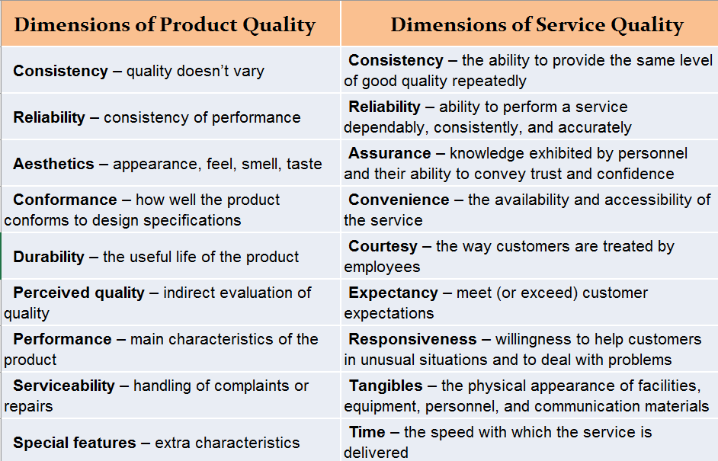

Slide 6
SERVQUAL: a tool for assessing service quality
Five dimensions of SERVQUAL
Tangibles
Reliability
Responsiveness
Assurance
Empathy

Slide 7
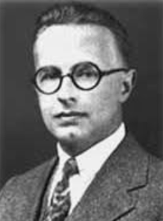
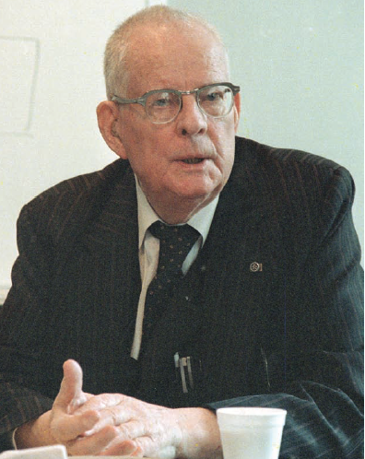
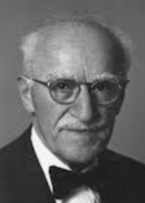
Quality Contributors
Walter Shewart
  “father of statistical quality control”
  Control charts
  Variance reduction
W. Edwards Deming
  Special vs. common cause variation
  The 14 points, Total Quality Management
Joseph Juran
  Quality Control Handbook, 1951
  Viewed quality as fitness-for-use
  Quality trilogy– quality planning, quality control, quality improvement

Slide 8
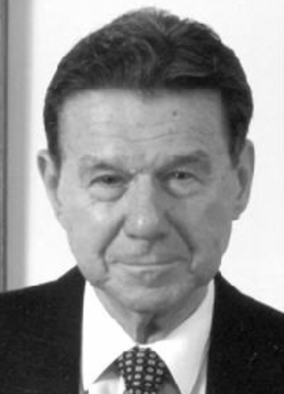
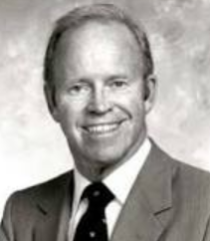
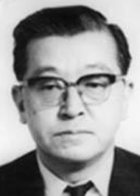
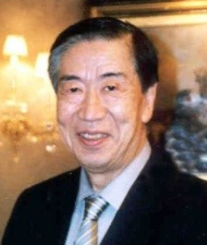
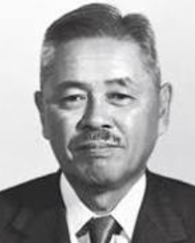
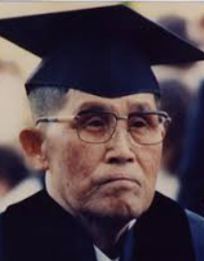
Quality Contributors (contd.)
Armand Feigenbaum
  Quality is a “total field”
  The customer defines quality
Philip B. Crosby
  Zero defects
  Quality is Free, 1979
Kaoru Ishikawa
  Cause-and-effect diagram
  Quality circles
  Recognized the internal customer
Genichi Taguchi
  Taguchi loss function
Taiichi Ohno and Shigeo Shingo
  Developed philosophy and methods of kaizen

Slide 9
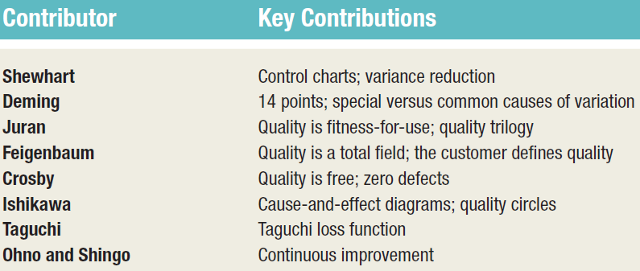

Slide 10
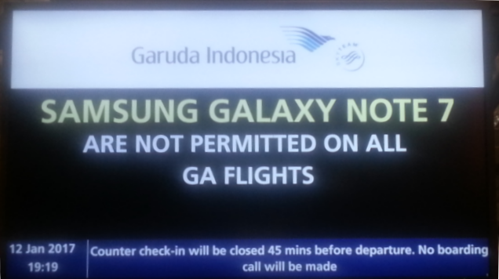
Costs of Quality
Appraisal Costs
  Costs of activities designed to ensure
  quality or uncover defects
Prevention Costs
  All training, planning, customer assessment, process control, and quality improvement costs to prevent defects from occurring
Failure Costs - costs incurred by defective parts/products or faulty services.
  Internal Failure Costs
    Costs incurred to fix problems that are detected before the product/service is delivered to the customer.
  External Failure Costs
    All costs incurred to fix problems that are detected after the product/service is delivered to the customer

Slide 11
Quality Certification
International Organization for Standardization
ISO 9000
  Set of international standards on quality management and quality assurance, critical to international business
ISO 14000
  A set of international standards for assessing a company’s environmental performance
ISO 24700
  Pertains to the quality and performance of office equipment that contains reused components

Slide 12
Quality Certification
ISO 9000
  Quality Principles
    Principle 1 Customer focus
    Principle 2 Leadership
    Principle 3 Involvement of people
    Principle 4 Process approach
    Principle 5 System approach to management
    Principle 6 Continual improvement
    Principle 7 Factual approach to decision making
    Principle 8 Mutually beneficial supplier relationships

Slide 13
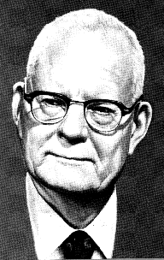


Quality Awards
Deming Prize
Australia
  1. JM Jurun award
  2. Kevin Foley award
  3. Shilkin award
European Foundation for Quality Model (EFQM) Excellence Award
Baldrige Award

Slide 14
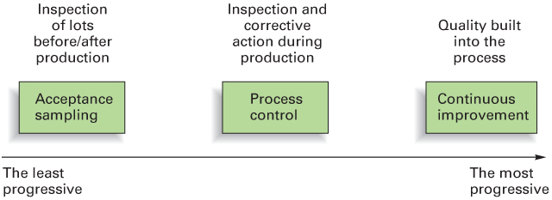
Phases of Quality Assurance

Slide 15
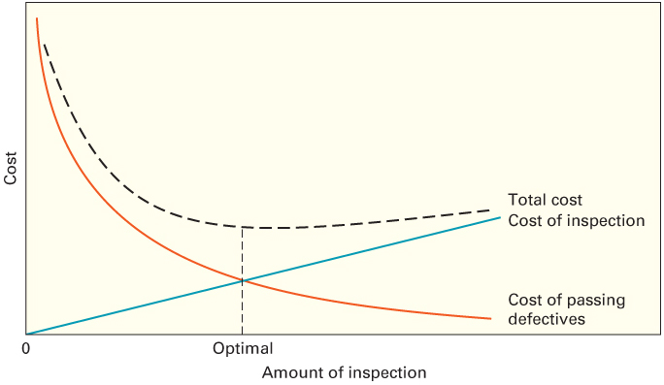
How Much to Inspect

Slide 16
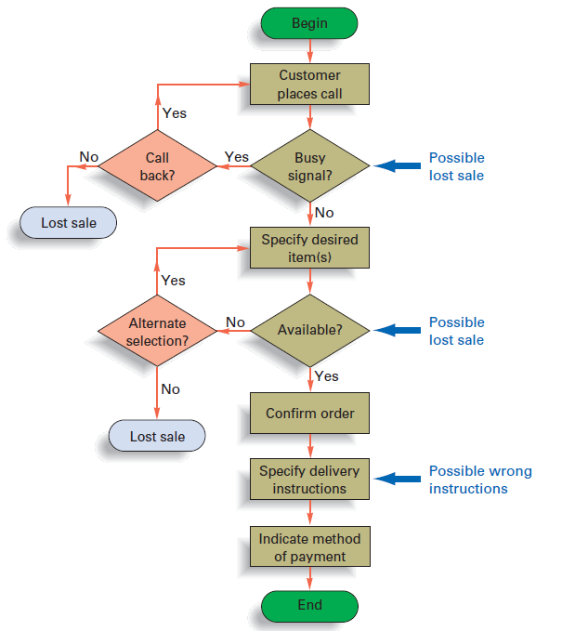
Seven Basic Quality Tools
1. Flowchart
A flowchart for catalogue
telephone orders

Slide 17
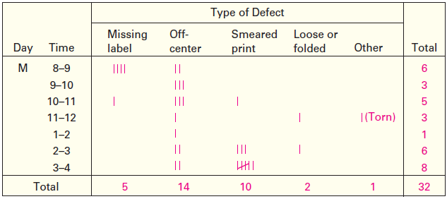
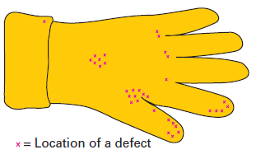
Seven Basic Quality Tools
2. Check Sheets
Examples of check sheets
For rubber glove

Slide 18
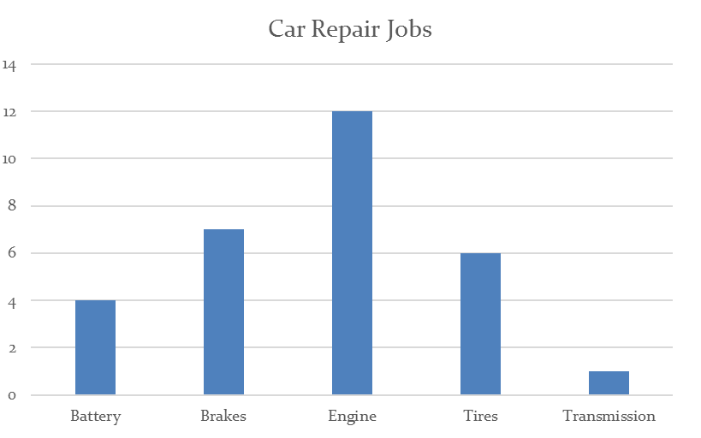
Seven Basic Quality Tools
3. Histograms.
A Histograms showing the distribution of
different types of repair jobs

Slide 19
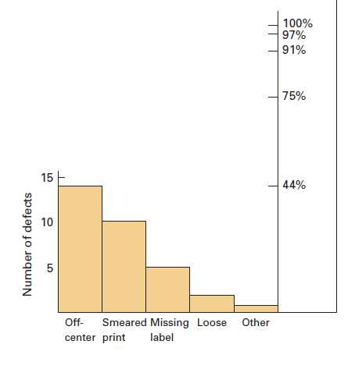
Seven Basic Quality Tools
4. Pareto Analysis
Technique for classifying problem areas according to degree of importance,
Check sheet for rubber glove
A Pareto diagram based on data in Check Sheet example

Slide 20
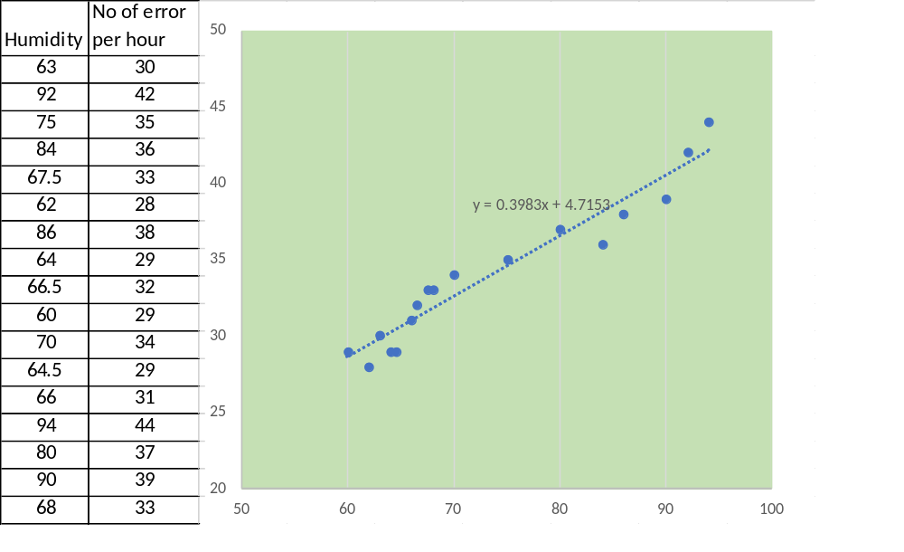
Seven Basic Quality Tools
5. Scatter diagram
A graph that shows the degree and direction of relationship between two
Variables
Example:

Slide 21
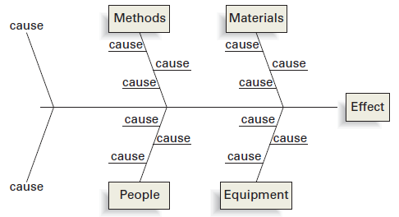
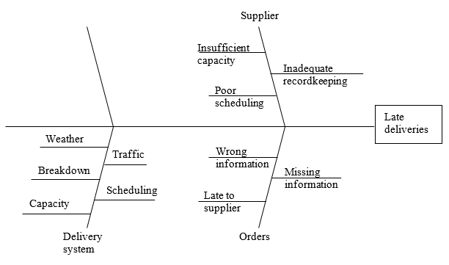
Seven Basic Quality Tools
6. Cause-and-Effect Diagrams
A diagram used to search for the cause(s) of a problem; also called fishbone diagram.
Cause-and-Effect Diagrams
for Late Delivery problem

Slide 22
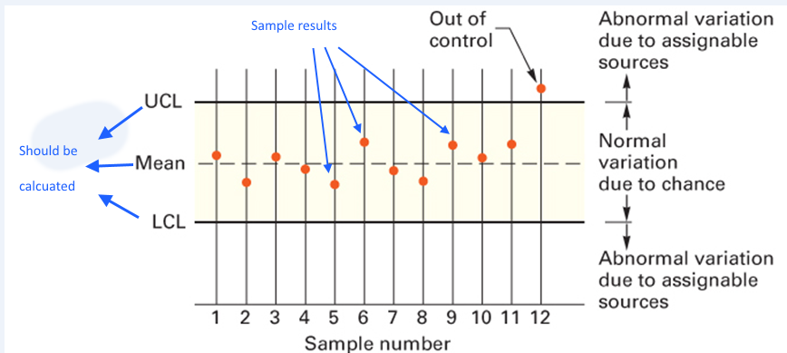
Seven Basic Quality Tools
7. Control Charts
  A time ordered plot of representative sample statistics obtained from an ongoing process (e.g. sample means), used to distinguish between random and nonrandom variability
A flowchart for catalog
telephone orders

Slide 23
Statistical Process Control (SPC)
Statistical evaluation of the output of a process
Helps us to decide if a process is “in control” or if corrective action is needed
SPC involves periodically taking samples of process output and computing sample statistics:

Slide 24
Process Variability
Variation
  Random (common cause) variation:
    Natural variation in the output of a process, created by countless minor factors
  Assignable (special cause) variation:
    A variation whose cause can be identified.
    A nonrandom variation
  Issue of Process Control
    Are the variations random? If nonrandom variation is present, the process is said to be unstable.
    Sample statistics are used to judge the randomness of process variation

Slide 25
Control Charts:
The Voice of the Process
Control Chart
  A time ordered plot of representative sample statistics obtained from an ongoing process (e.g. sample means), used to distinguish between random and nonrandom variability
  Control limits
    The dividing lines between random and nonrandom deviations from the mean of the distribution
    Upper and lower control limits define the range of acceptable variation

Slide 26
Types of Data
Variables
Attributes
Characteristics that can take any real value such as weight, speed, height, or strength
May be in whole or in fractional numbers
Continuous random variables
Defect-related characteristics
Classify products as either good or bad or count defects
Categorical or discrete random variables
  Does not address degree of failure

Slide 27
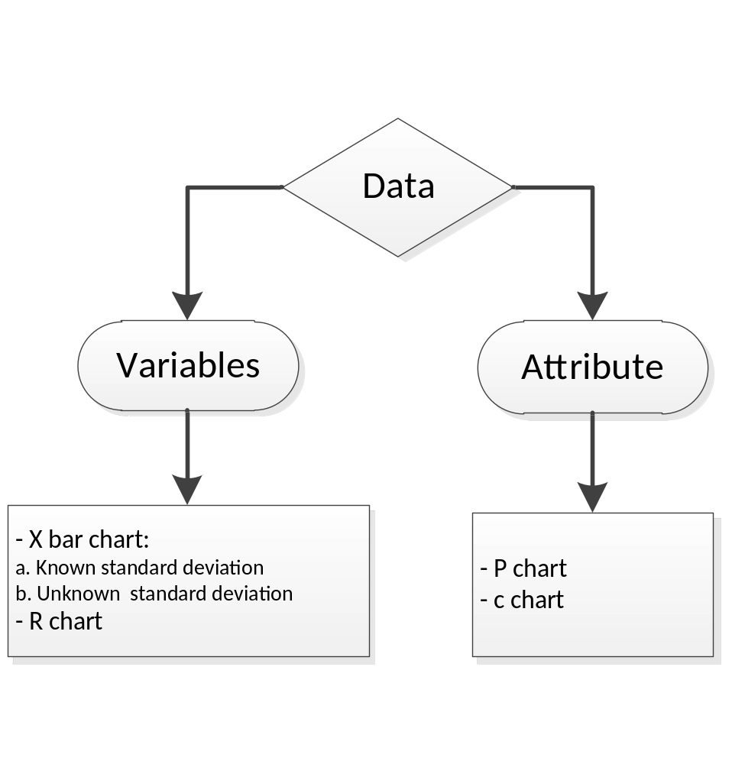
Control Charts for Data Types

Slide 28
Control Charts for Attributes
Attributes generate data that are counted.
  p-Chart
    Control chart used to monitor the proportion of defectives in a process
  c-Chart
    Control chart used to monitor the number of defects per unit

Slide 29
Use a p-chart:
When observations can be placed into two categories.
  Good or bad
  Pass or fail
  Operate or don’t operate
When the data consists of multiple samples of several observations each

Slide 30
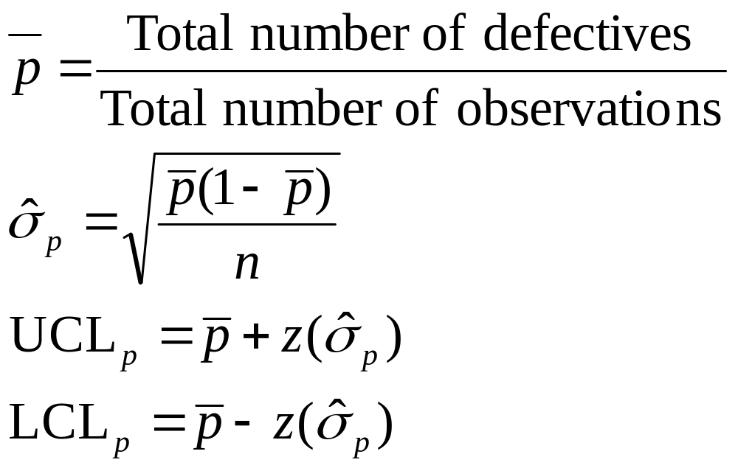
p-chart Control Limits

Slide 31
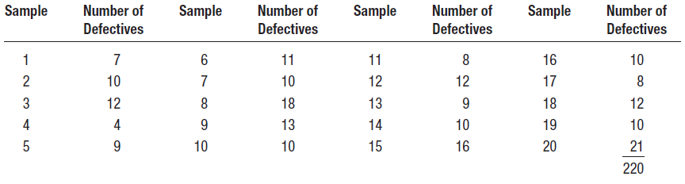
p-chart Example
An inspector counted the number of defective monthly billing statements of a telephone company in each of 20 samples. Using the following information, construct a control chart that will describe 99.7 percent of the chance variation in the process when the process is in control. Each sample contained 100 statements.

Slide 32
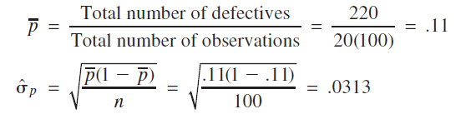

p-chart Example
Solution
To find z, divide 0.9974 by 2 to obtain 0.4987, and using that value, refer to Appendix B, Table A to find z 3.00.

Slide 33
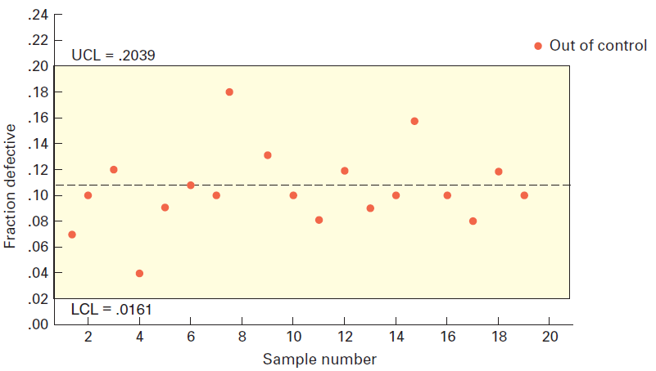
Process is out of control

Slide 34
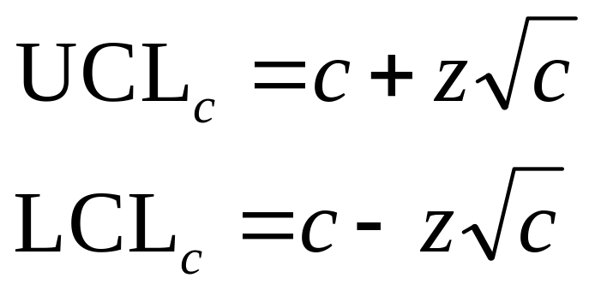
c-chart
Use only when the number of occurrences per unit of measure can be counted; non-occurrences cannot be counted.
  Scratches, chips, dents, or errors per item
  Cracks or faults per unit of distance
  Breaks or Tears per unit of area
  Bacteria or pollutants per unit of volume
  Calls, complaints, failures per unit of time

Slide 35
c-chart Example
A cab company receives several complaints per day about the behaviour of its drivers. Over a nine-day period, the owner received the following numbers of calls from irate passengers: 3,0,8,9,6,7,4,9,8, for a total of 54 complaints. He wants to compute 99.7% control chart limits.
Solution:
c = 54 complaints/9 days = 6 complaints/day
UCL_{c} = c + 3 c
= 6 + 3 6
= 13.35
LCL_{c} = c - 3 c
= 6 - 3 6
= 0
Is the process in control?

Slide 36
Question

